Slide 1
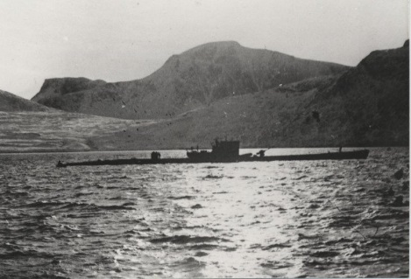
Special U-boat Operations
In Canadian Waters
Captain Jerry Mason, USN (ret.) VE7YAB
U-boat Archive Website http://uboatarchive.net

Slide 2
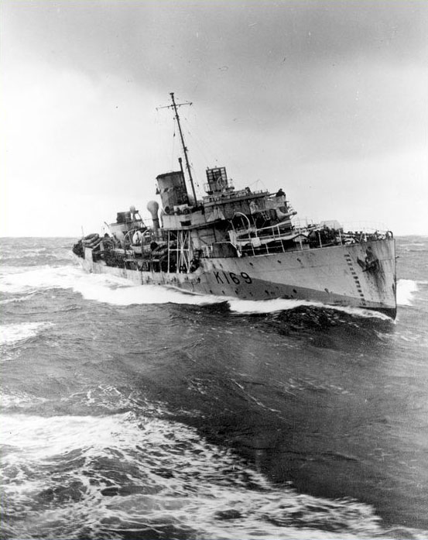
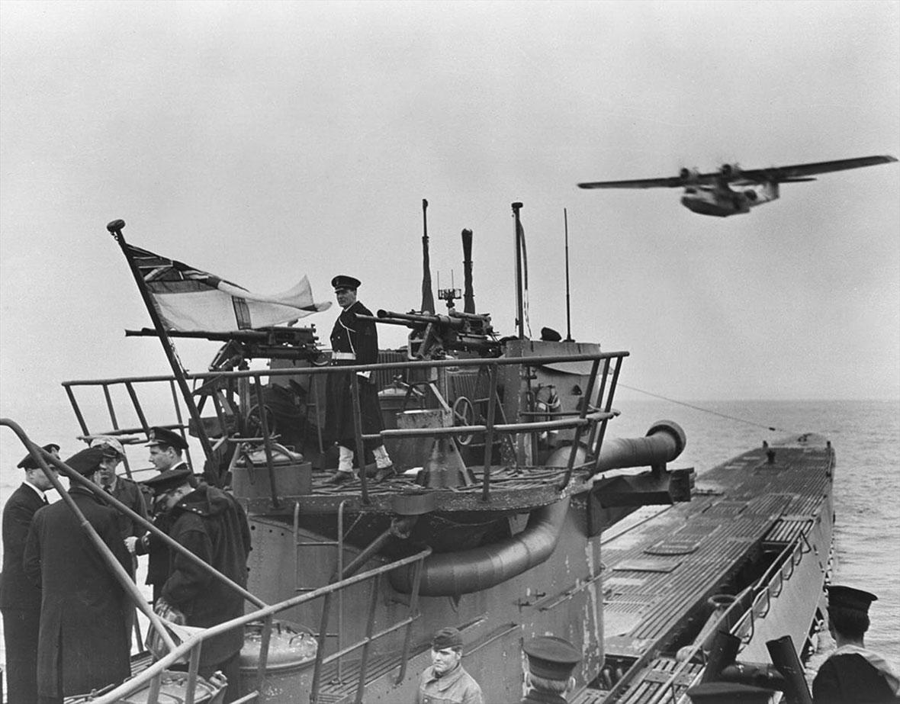
Battle of the Atlantic
Battle of the Atlantic was the longest campaign in WWII
Canada’s merchant navy went from 38 to 400 sea-going ships – the Navy from about 13 to over 400 ships – the Air Force from about 15 to 86 squadrons
30 U-boats were lost to the RCN – 19 to the RCAF
HMCS Rosthern
U-889 and RCAF Canso
Notes:
Every Canadian should be proud
Steep learning curve - over 4600 Canadians lost
30 U-boats were lost to the RCN - 19 to the RCAF

Slide 3
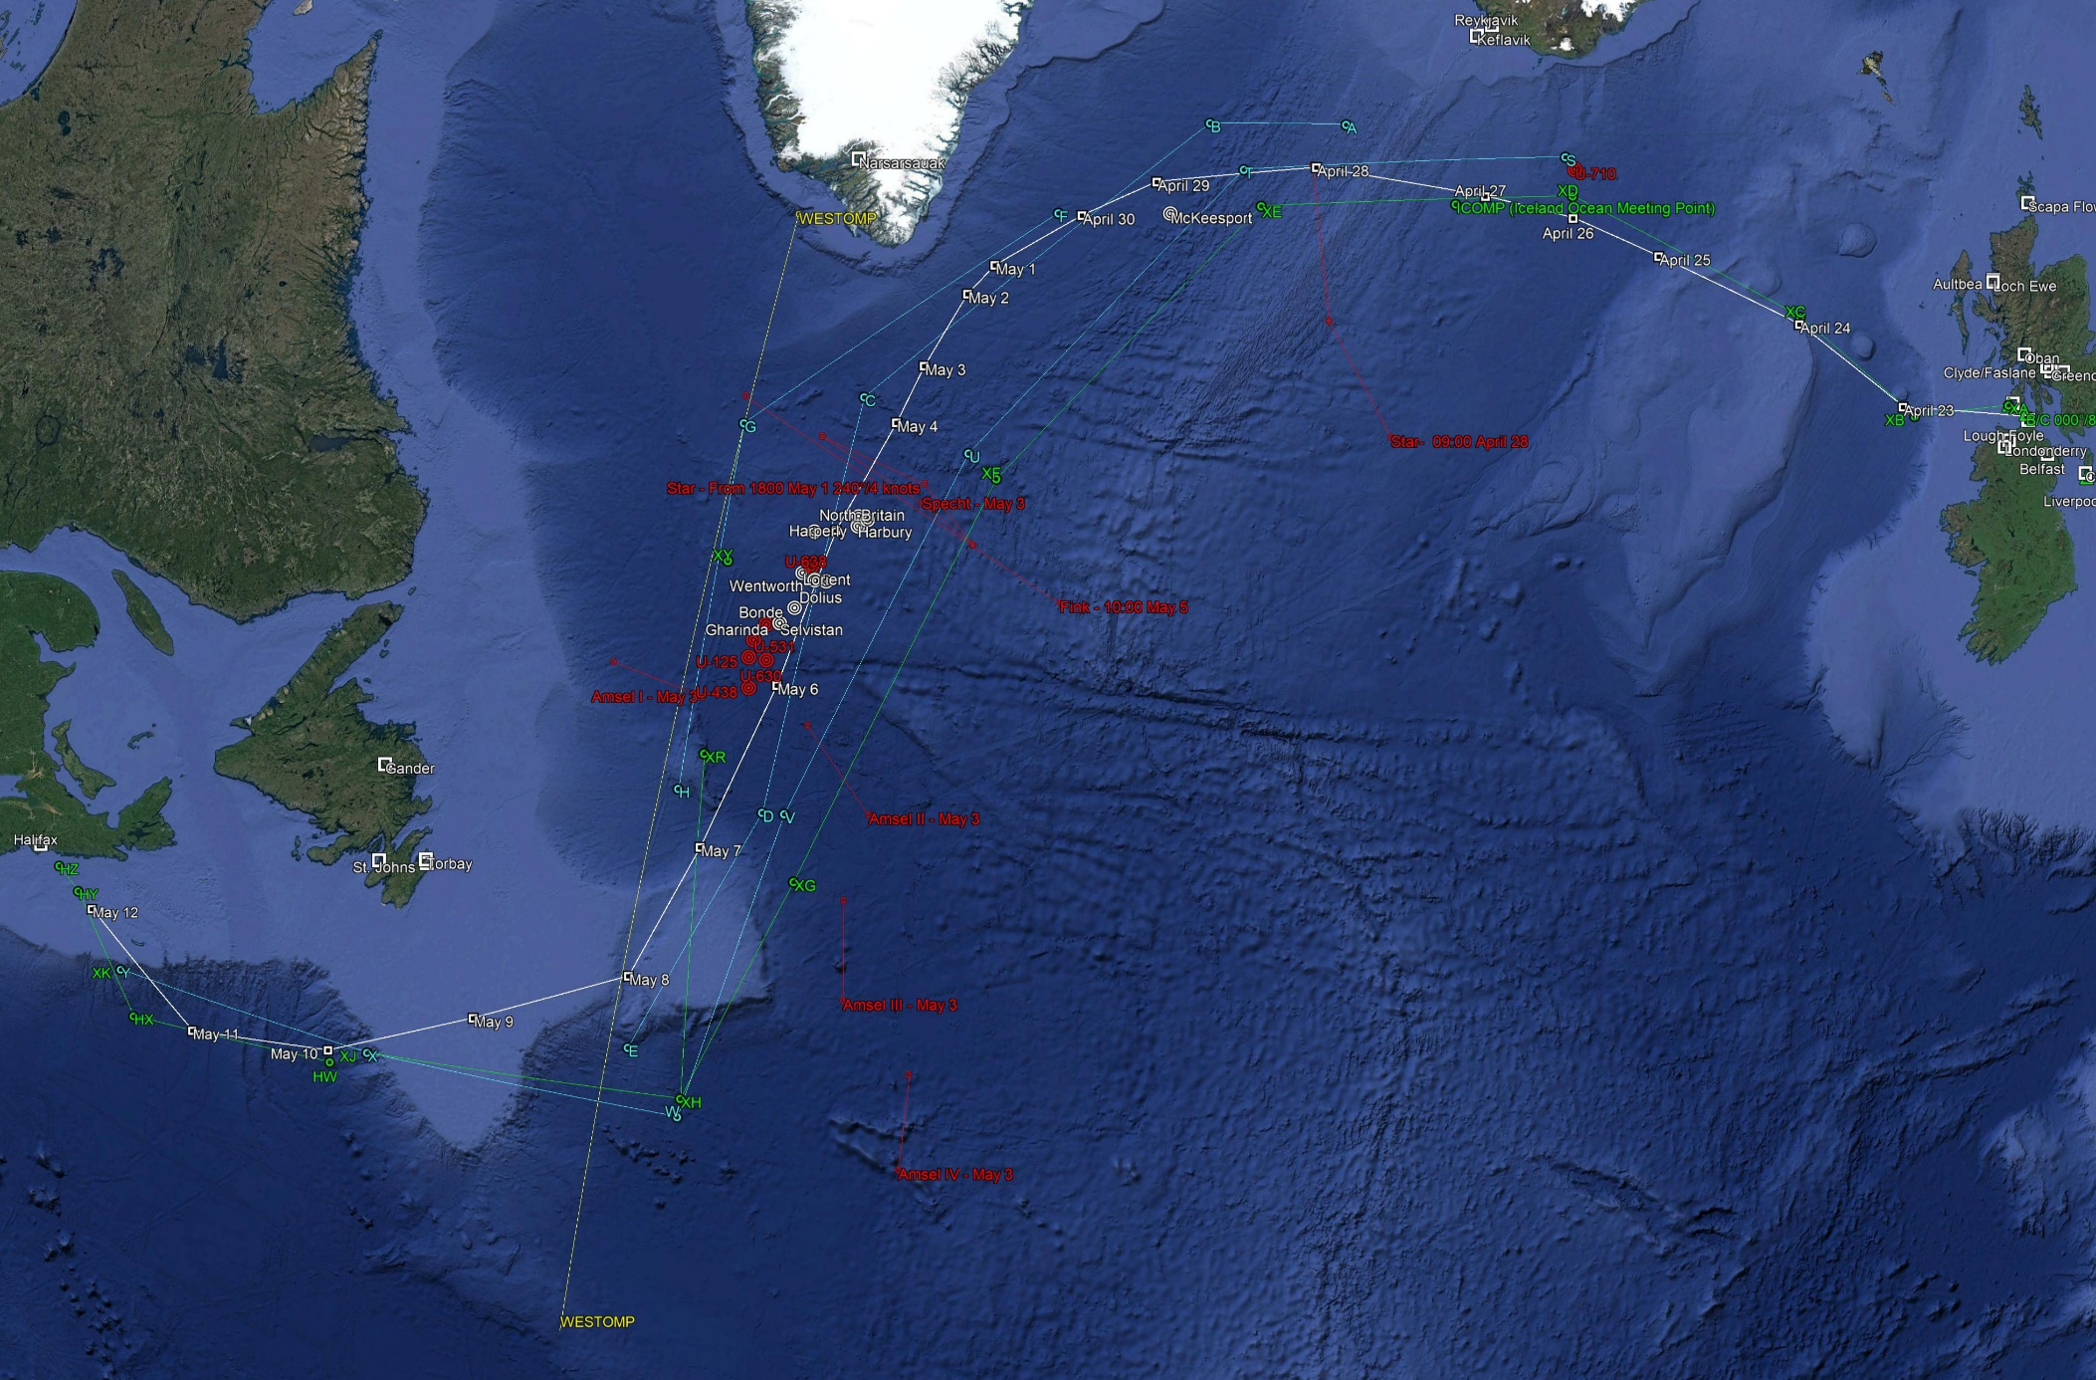
May is Battle of the Atlantic Month – ONS 5
Notes:
ONS 5 turning point in the Battle of the Atlantic
42 Allied ships and 16 escorts
13 ships sunk – 6 U-boats sunk

Slide 4
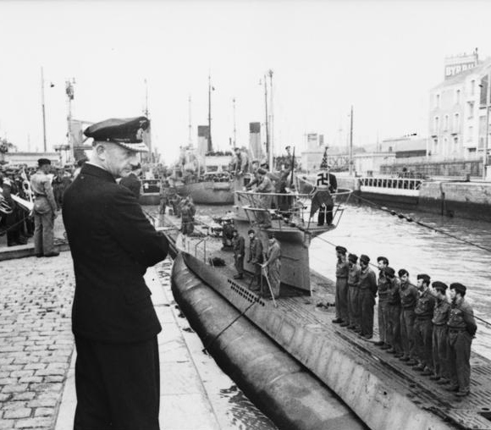
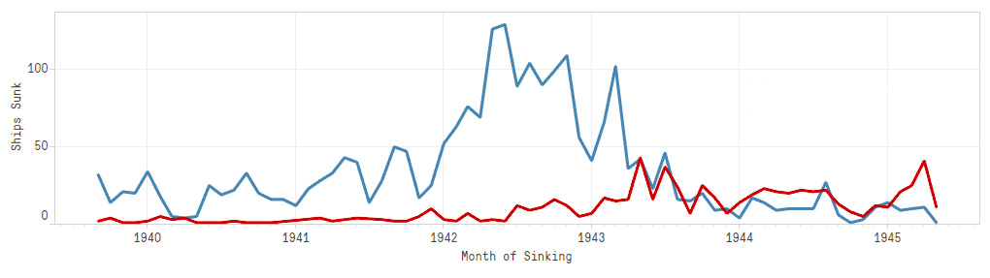
Why Special Operations?
German Navy’s objective: commerce warfare
Admiral Dönitz thought in terms of a tonnage war
Special operations entailed considerable outlay
Spy landings & weather stations: jobs that had to be done
POW pickups: encourage imprisoned men, disrupt the enemy, propaganda
Ships sunk vs U-boats sunk
Notes:
Germany’s Navy was no match for the Royal Navy
Key metric: tonnage sunk/U-boat days at sea
U-94 St. Nazaire 4 Jun 1941 26,767 GRT

Slide 5
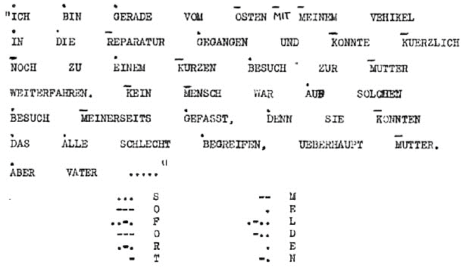
POW Pickups - Communications
U-boat Officers communicated with Admiral Dönitz by a simple code
The first letter of each word indicated a dot, dash or blank
Letters A - I represented DOTs, J - R DASHes, S - Z BLANKS
Notes:
Code known as “Ireland”
POW mail was sent to relatives passed on to U-boat Headquarters
It took up to three months for a message to get through
About a year to arrange a pickup

Slide 6
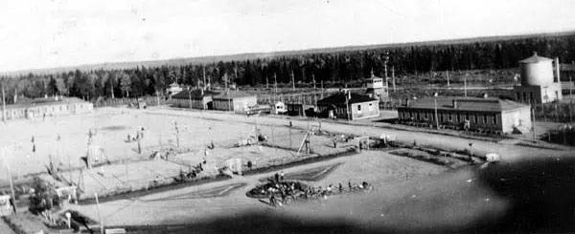
Operation Elster (Magpie)
Escape from Camp 70 B near Fredericton, NB
Site was a relief camp during the depression
1940-1941 an internment camp for Jewish refugees
1941-1945 a POW camp for Germans, Italian Merchant Mariners & Canadians
Notes:
Fritz Bender inventor of waterproof plywood used in Mosquito aircraft
Camillien Houde, Mayor of Montreal

Slide 7
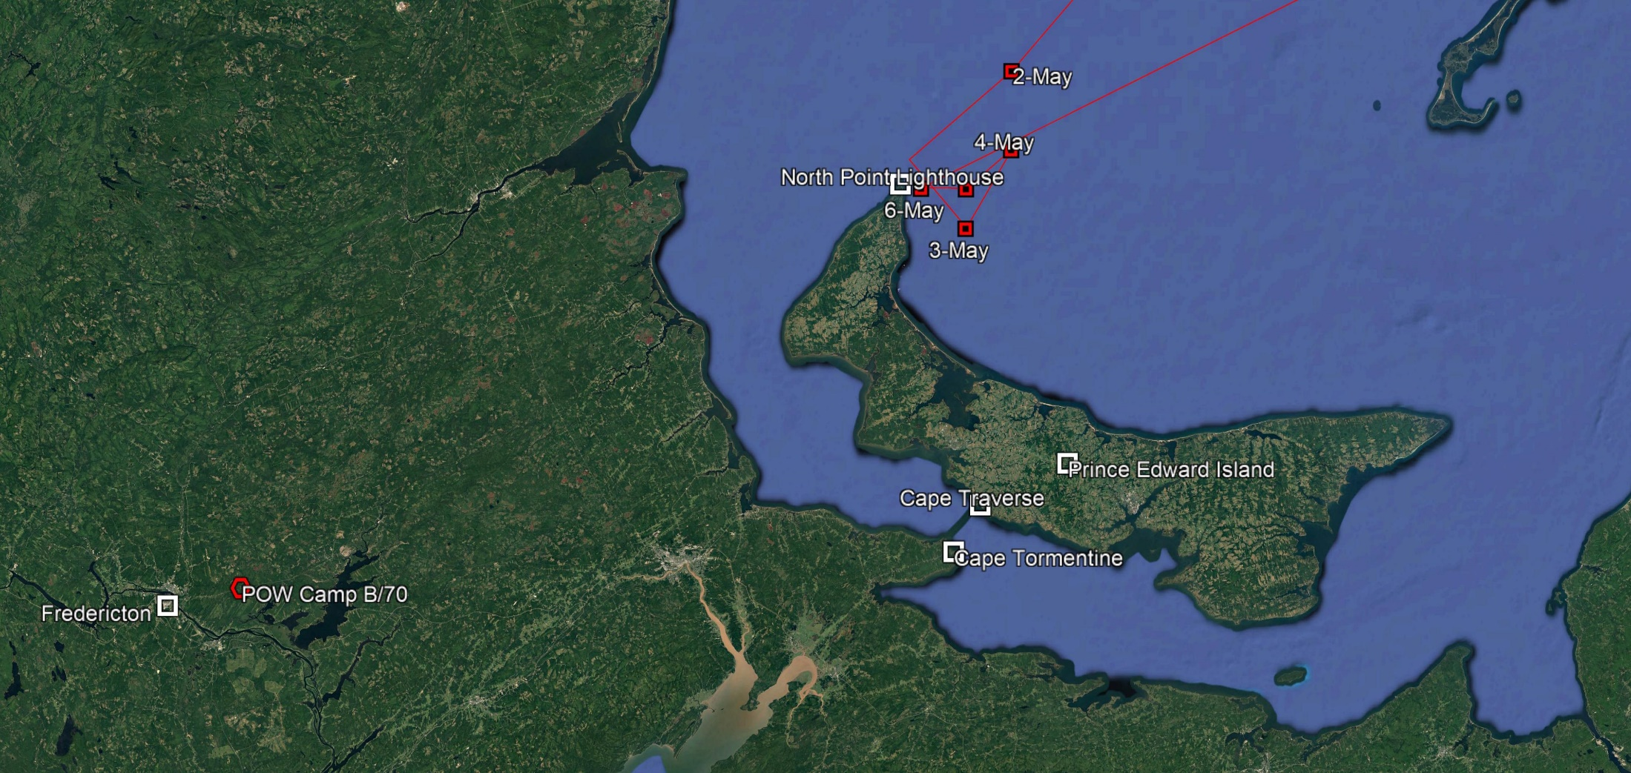
Operation Elster (Magpie)
Admiral Dönitz set a pickup date of 2 May 1943
Maps, money, identity documents were sent in Red Cross packages
278 km to Cape Tormentine – 14 km across the strait – 95 km to North Point
Notes:
Communications began in early 1942
Pickup date 2 May 1943

Slide 8
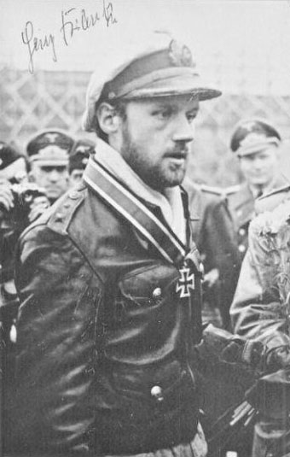
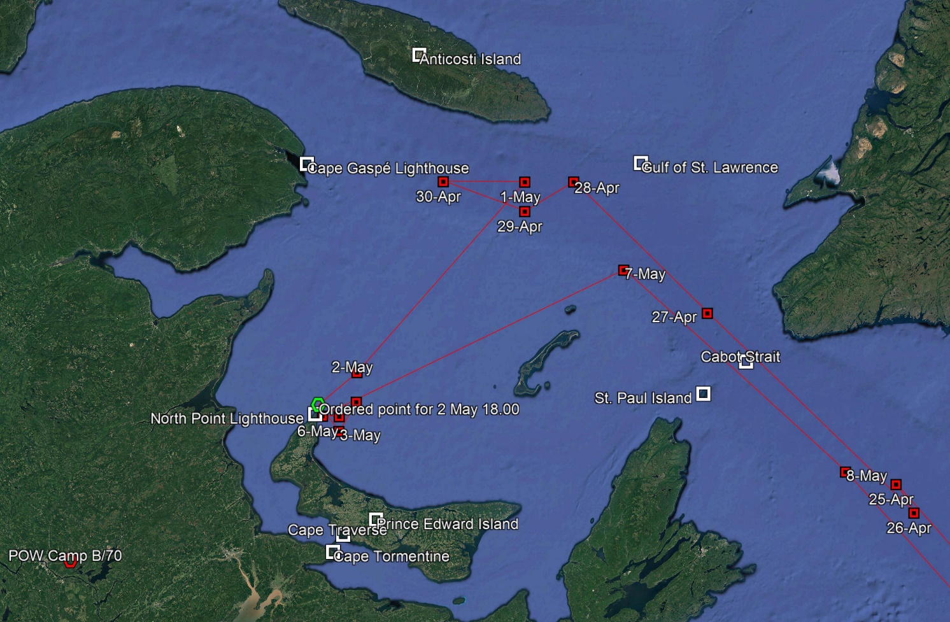
Operation Elster (Magpie)
U-376 originally tasked - lost crossing the Bay of Biscay
U-262 Kptlt. Heinz Franke was the backup - carried sealed orders
Departed Lorient 27 Mar – Arrived at the Cabot Strait 26 Apr
16 hour under ice transit – Waited 2-6 May at pickup point
Notes:
Route and tactics at own discretion
Charts inadequate
16-hour Ice transit damaged the boat
Avro Ansons from RCAF Station Summerside

Slide 9
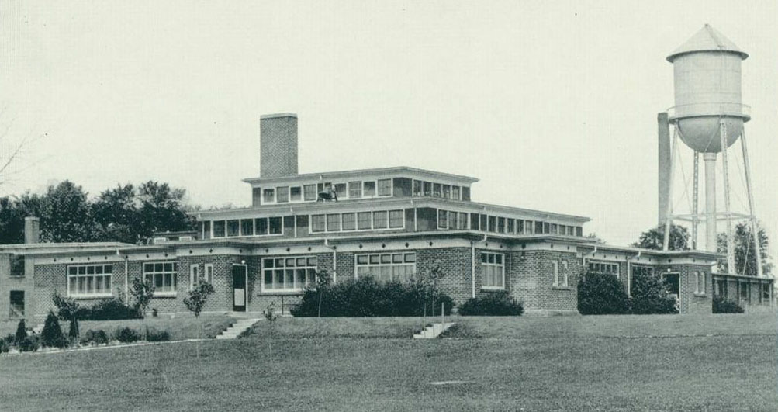
Operation Kiebitz (Lapwing)
Escape from Camp 30 Bowmanville, ON – former Bowmanville Boys Training School
1941-1945 POW camp for about 800 German Army, Air Force and Navy Officers
Battle of Bowmanville 10-12 Oct 1942 – POWs shackled in response to Hitler’s “Commando” order
Notes:
Commando Order – Dieppe Raid
Canadian POWS were to be shakled

Slide 10
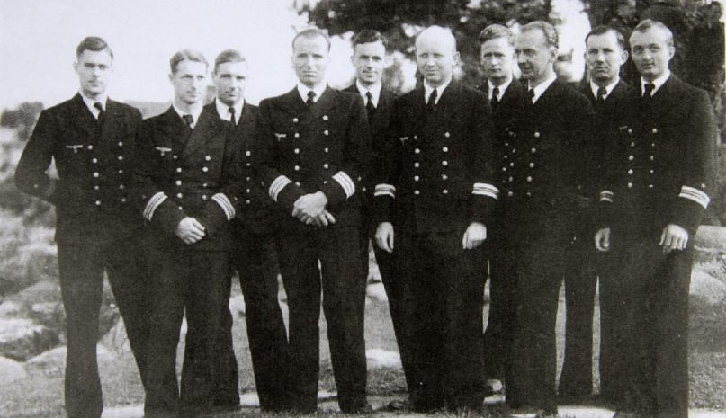
Operation Kiebitz (Lapwing)
Oct 42 Fkpt. Otto Kretschmer proposed an escape of 4 U-boat officers
Admiral Dönitz approved, later setting a pickup date of 23 Sep 43
3 tunnels were started, civilian clothes and dummies as substitutes for escapees
Tunnel was over 100 meters long with a trolley system, ventilation & lights
Canadian authorities intercepted messages – allowed the escape to proceed
One week prior to the escape the tunnel was “discovered”
Kptlt. Wolfgang Heyda (U-434) proposed his own escape plan
Fkpt. Otto Kretschmer and U-boat Commanders
Notes:
Kretschmer – U-99 – 40 ships sunk 208,954 GRT
Knights Cross with Oak Leaves and Crossed Swords
Otto Kretschmer (U-99), Horst Elfe (U-93), Hans Ey (U-433), Hans Joachim Knebel-Döberitz; U-99 Second Officer & Dönitz adjutant

Slide 11
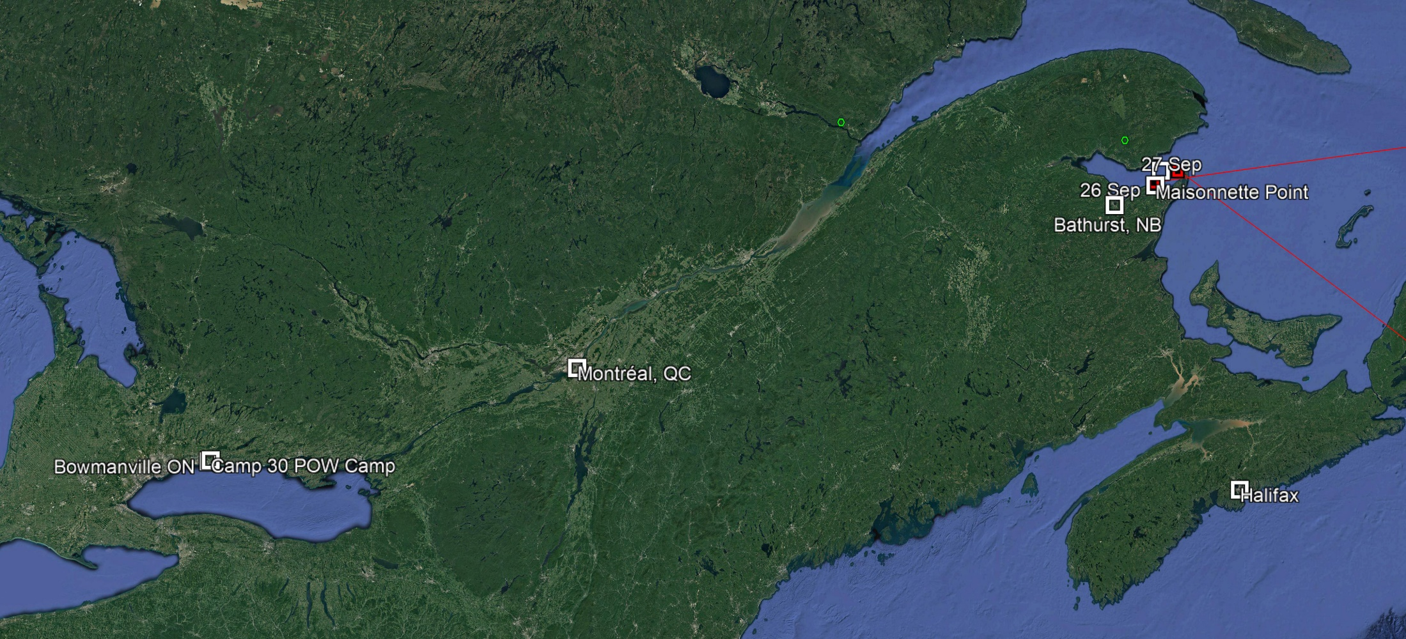
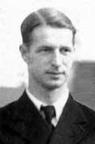
Operation Kiebitz (Lapwing)
Heyda escaped 24 Sep by climbing a power line with home made linesman spikes and using an improvised zip line to get over the fence
By train 450 km from Bowmanville ON to Montréal, QC
Switched trains 650 km to Bathhurst, NB

Slide 12
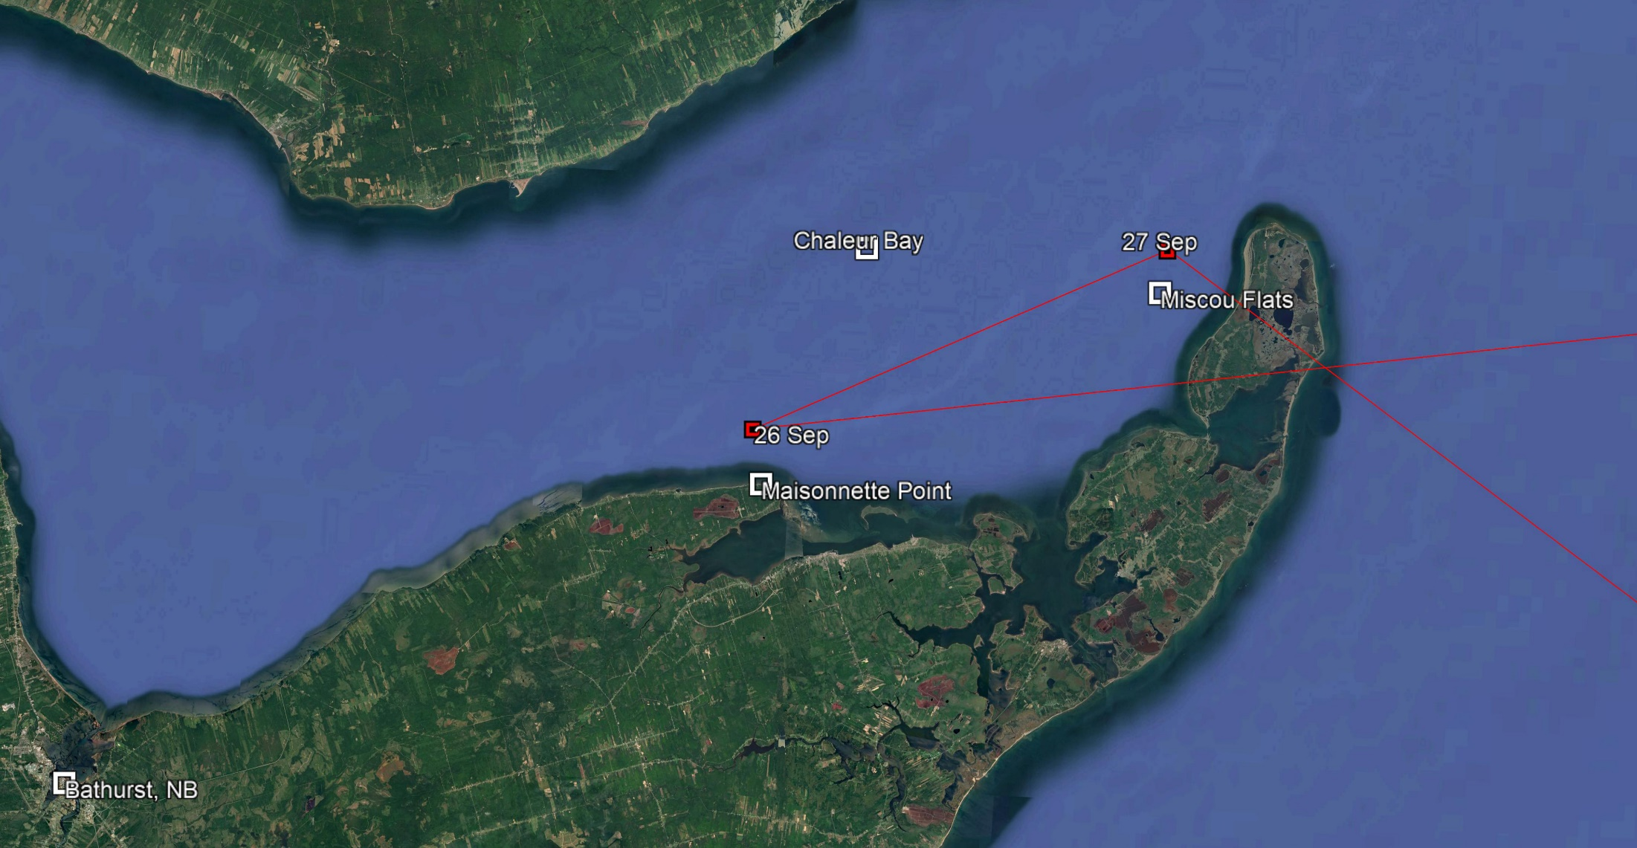
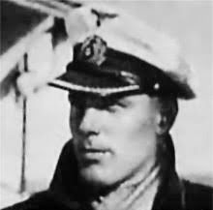
Operation Kiebitz (Lapwing)
55 km on foot to Maisonnette Point – passed through an Army check point and camped on the beach the evening of 26 Sep
U-536 Kptlt. Rolf Schauenburg was tasked with the pickup – ordered to arrive 26 Sep
Notes:
Schauenburg Graf Spee officer - Interned and escaped to Chile

Slide 13
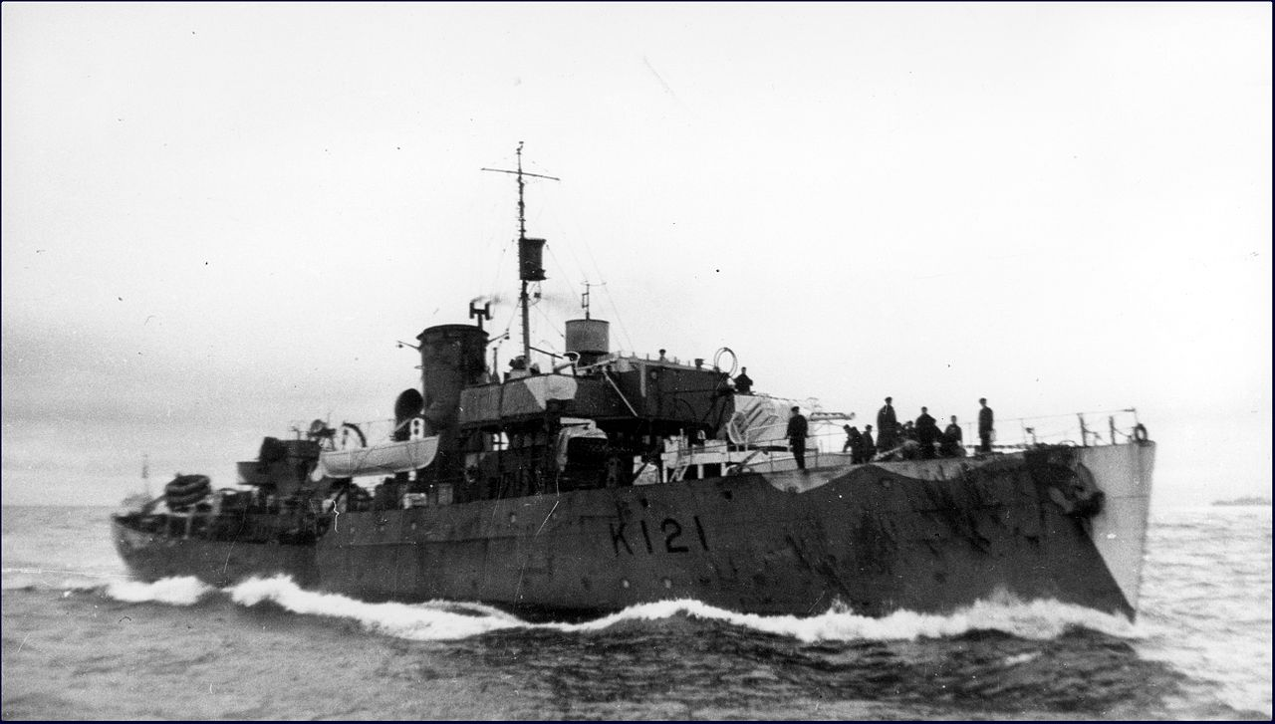
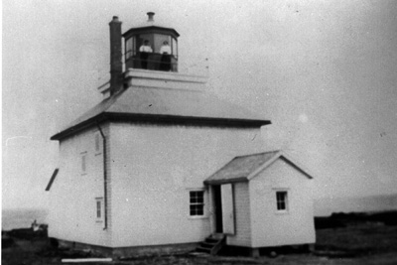
Operation Pointe Maisonnette
Canadian Navy and Army established a portable surface radar array on shore
A task force of several ships centered on HMCS Rimouski prepared to capture U-536
HMCS Rimouski was fitted with an experimental diffuse lighting array
Heyda was arrested at about 21.00 on 27 Sep 1000 meters from the pickup point
U-536 sensed a trap and escaped – was sunk attacking a convoy on 20 Nov
HMCS Rimouski
Point Maisonnette Lighthouse
Notes:
Warnings led to formation of RCN/CA/RN/RCMP task force
9 ship task force centered on HMCS Rimouski
U-536 joined Group Schill shadowing convoy MKS-30
HMCS Snowberry and Calgary and HMS Nene
17 of 55 taken prisoner including Schauenburg

Slide 14
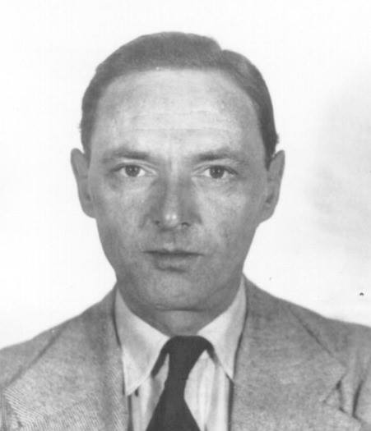
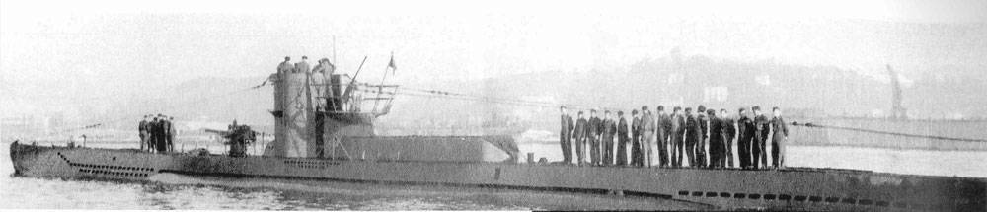
Operation Grete
Abwehr agent Marius Langbein landed near St. Martins , NB on 14 May 1942
Langbein had lived in Canada from 1928 to 1932 – returned to Germany – married – drafted for service in the Army – trained in espionage
Mission: observe and report on the locations of Canadian industry and activity around the ports of Montreal and Halifax – sabotage was forbidden
U-213 Oblt. Amelung von Varendorff was tasked to deliver the agent
Notes:
U-213 was a type VIID mine-laying boat

Slide 15
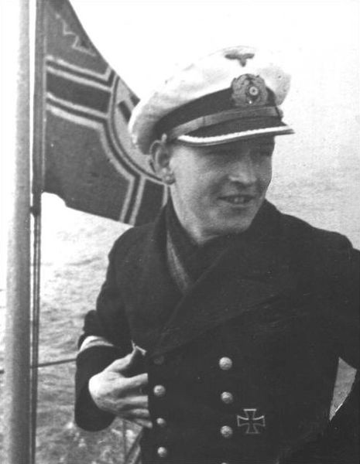
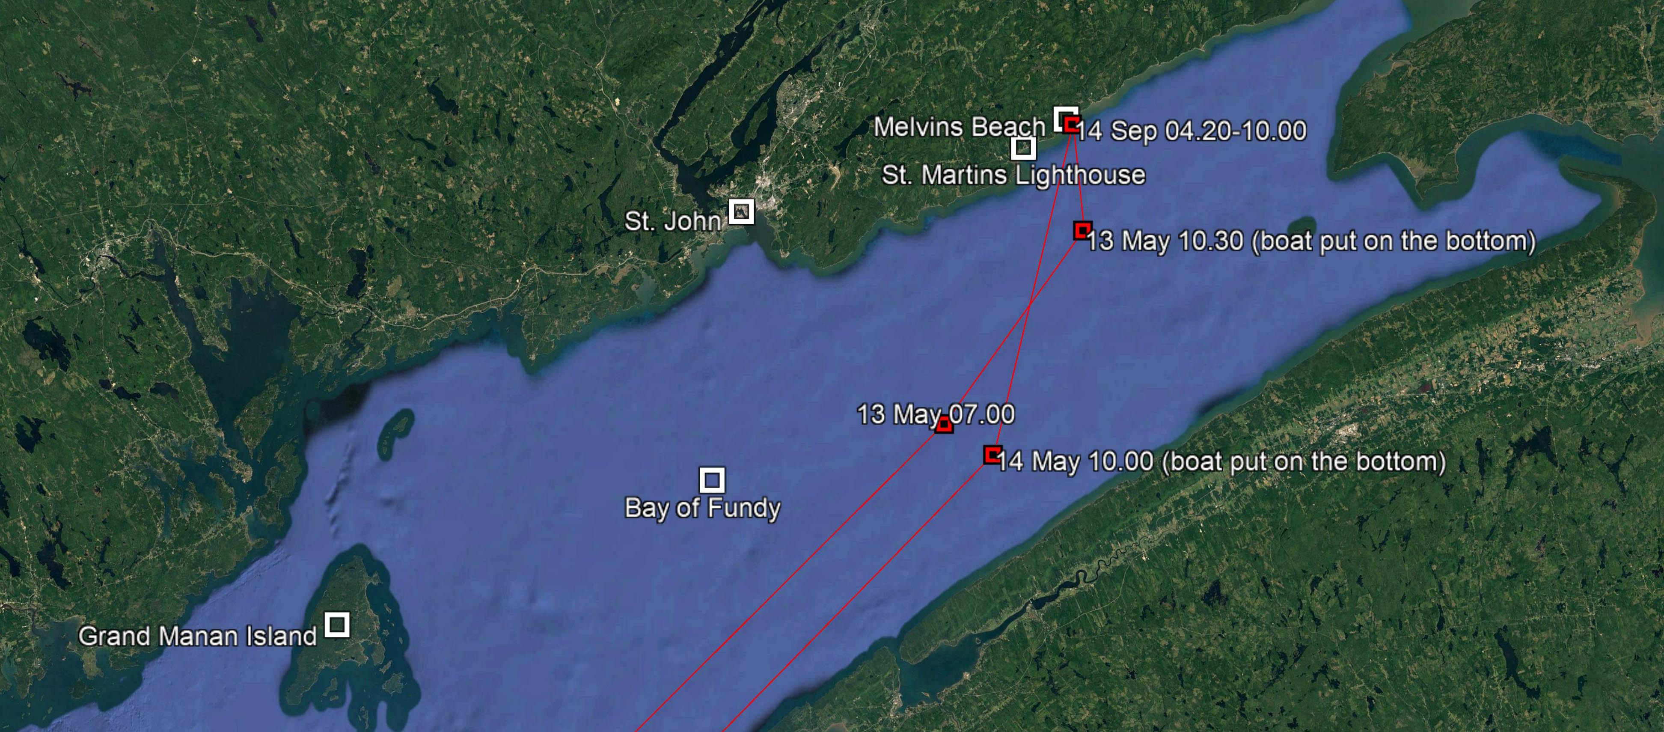
Operation Grete
Langbein burried his naval uniform and his radio and set off for Montréal, QC
After a month he moved to Ottawa where he lived until his money ran out
1 Nov 44 he surrendered to the Naval Intelligence Directorate – Tried and acquitted
Notes:
00.20 boat under Second Officer shoved off
04.30 finally returned
Most of Langbein’s money was obsolete bills 2/3 larger than current bills
Arrested in a brothel released

Slide 16
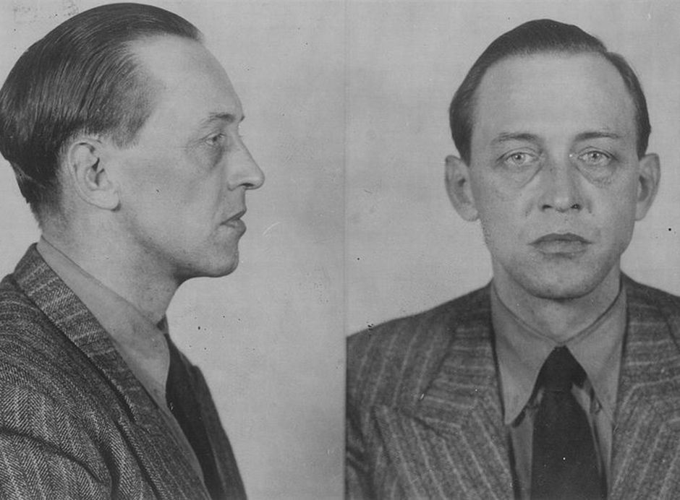
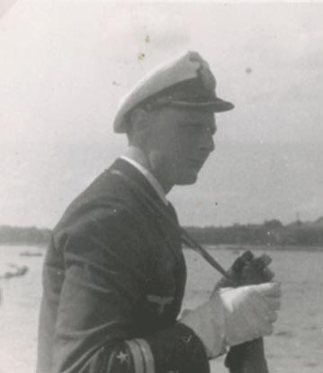
Operation Bobbi/Watchdog
Abwehr agent Werner von Janowski landed near New Carlisle, QC on 9 Nov 1942
Janowski lived in Canada from 1930-1938 – returned to Germany – drafted for service in the Army – trained in espionage
Mission: link up with Nazi sympathizers in Montreal
U-518 Oblt. Friedrich-Wilhelm Wissmann was tasked to deliver the agent

Slide 17
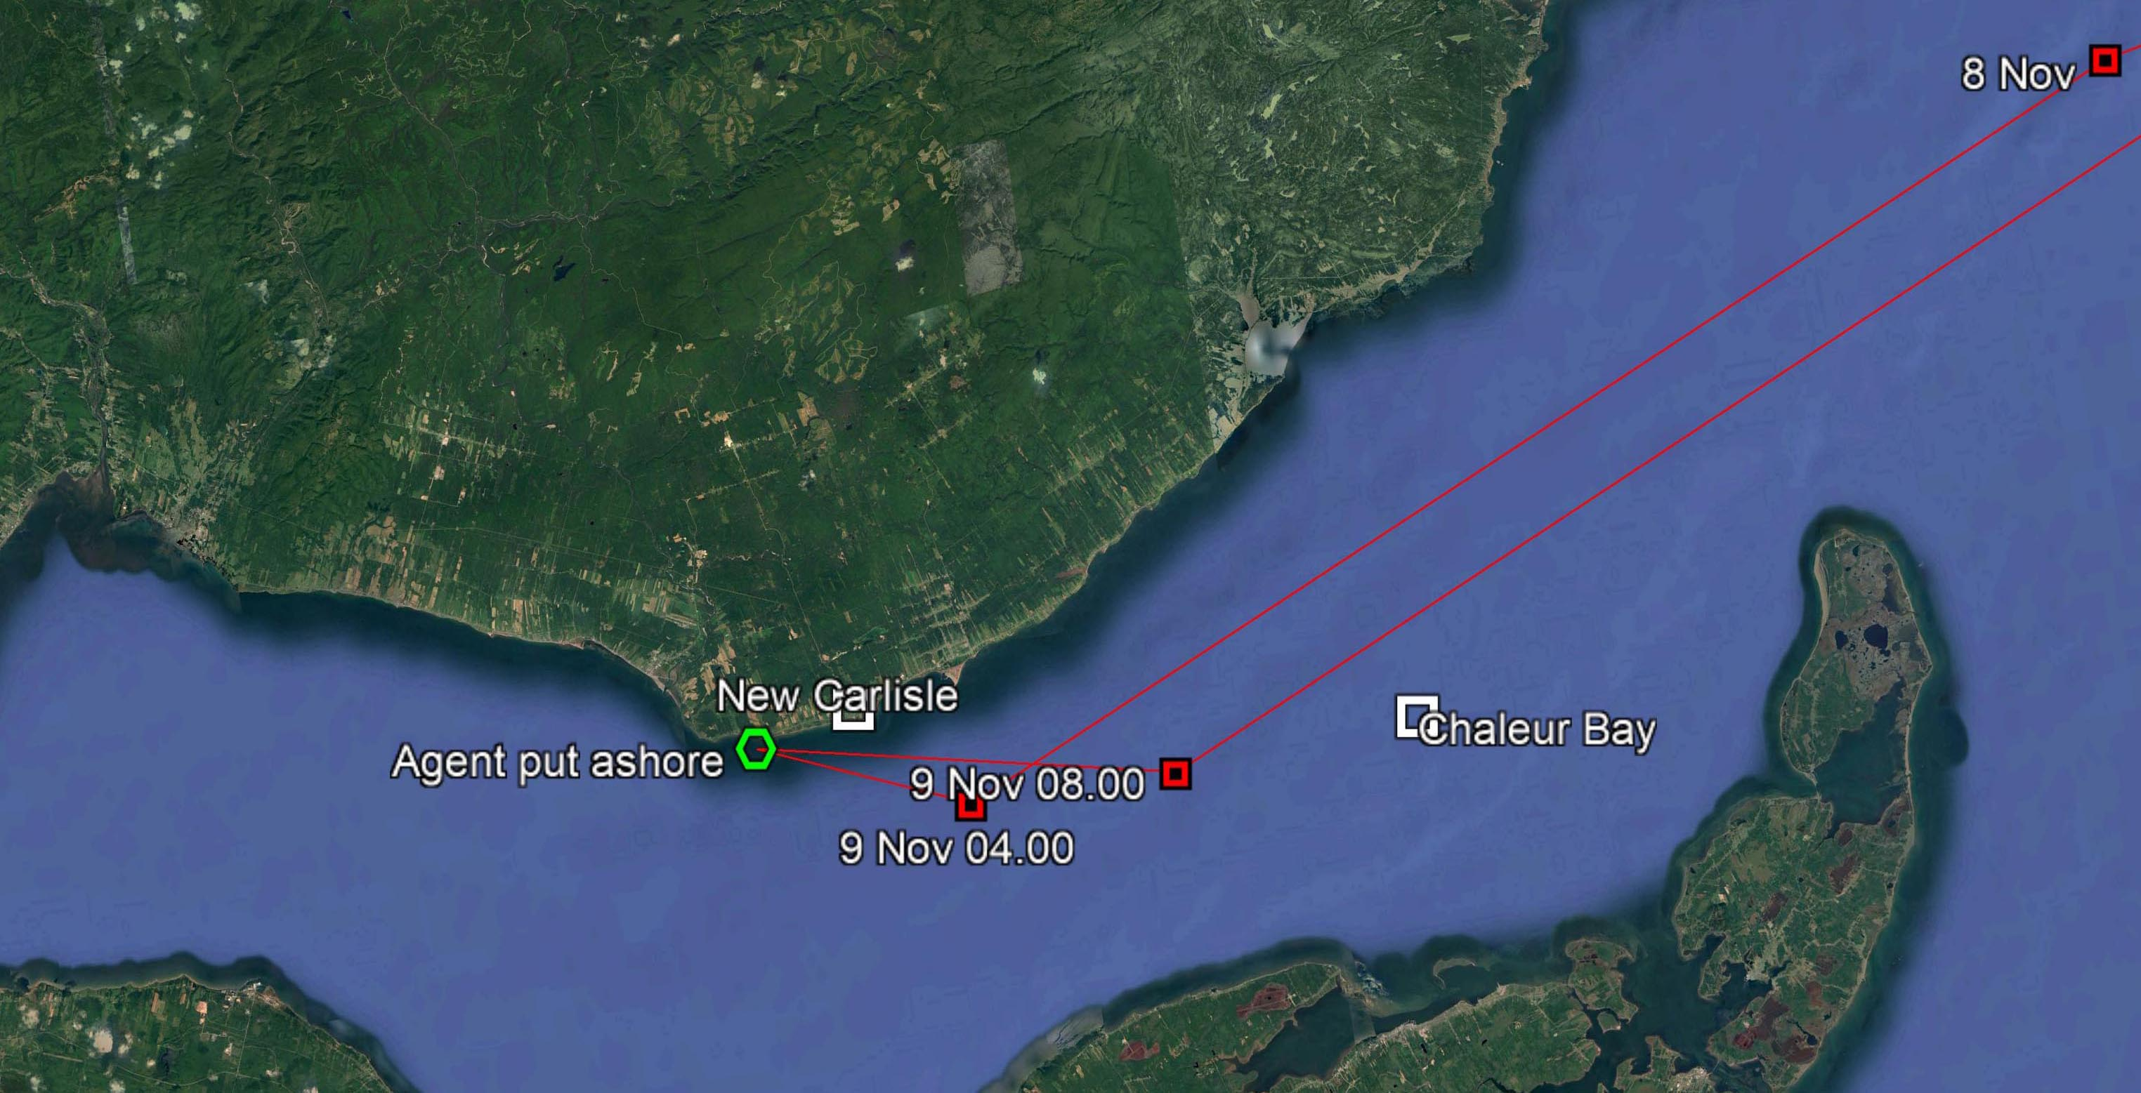
Operation Bobbi/Watchdog
U-518 operated for 45 days sinking two ships before landing Janowski
Spotted by the son of a hotel owner and arrested within 12 hours
RCMP and Military intelligence tried to turn Janowski into a double agent
Notes:
U-518 left Kiel 26 Sep 1942 - Operated off Bell Isle Strait for two weeks - Penetrated Conception Bay attacking the Bell Island Anchorage
Suitcase contained: pistol, brass knuckles, coding material, secret writing mediums, two books in English, emergency rations, various maps of eastern Canada, identity papers, $5000 in Canadian currency (mush of it out of date), $1000 in US gold pieces
Hotel owner’s son Earle Arnnett – Shore Patrol – Quebec Provincial Police - RCMP

Slide 18
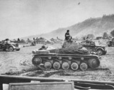
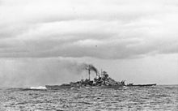
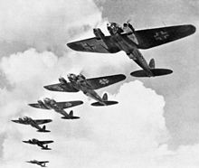
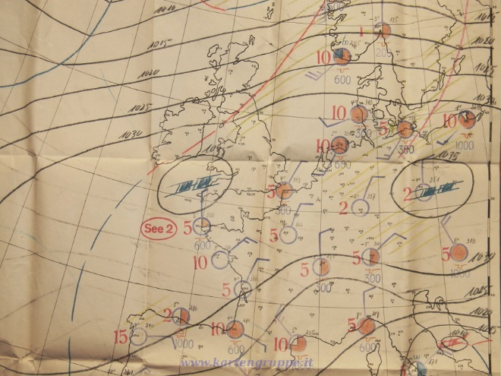
German Meteorological Activities in WWII
Weather has always been important in military operations
Blitzkrieg France
Bismarck breakout
Battle of Britain
European weather forms in the Arctic moving west to east
At first neutral Denmark and Norway transmitted weather reports in international code
Cooperation ceased after the invasion of Denmark and Norway in April 1940

Slide 19
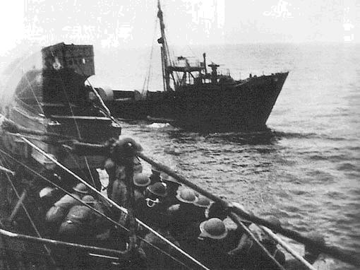
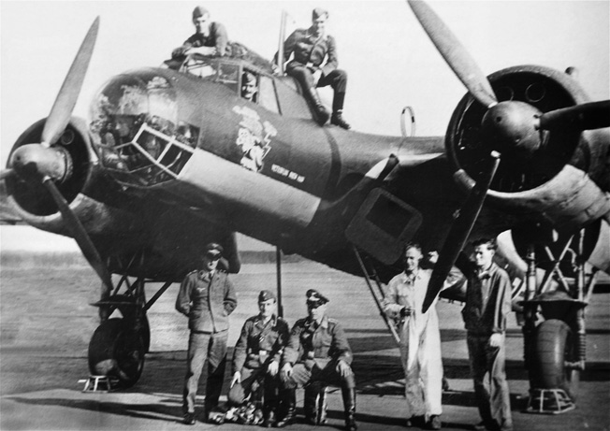
German Meteorological Activities in WWII
Initially weather reporting by weather trawlers – with disastrous consequences
Two U-boats continually assigned from August 1940 to January 1941
The Plan:
Manned stations reported from remote sites during winter months
Automatic weather stations on land and sea covered the summer months
U-boats ferried personnel to and from manned weather stations, and deployed automatic weather stations
German Air Force performed weather reconnaissance with aircraft and manned and automatic stations
HMS Tatar seized Lauenburg 28 June 1941
Weather Reconnaissance DO 17 1940

Slide 20
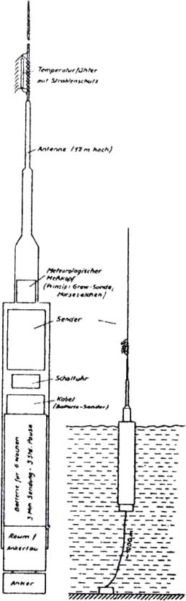
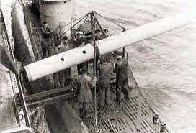
Weather Radio Sea WFS
7 meter long x 52 cm diameter steel cylinder – 12 meter antenna
Weight 1500 kg Anchor up to depth 300 meters
Air pressure (aneroid barometer) and temperature (helix bimetallic)
Sampled 4 times/day - Encrypted into Morse – transmitted 10 times on HF in 60-80 seconds
Designed for endurance of 10 weeks
WFS 106 being loaded aboard U-703 in Trondheim 18 July 1943
Notes:
Developed for the Naval Weather Service by Siemens and Schukert
Designed and tested from 1940 – 40 ordered in 1942

Slide 21
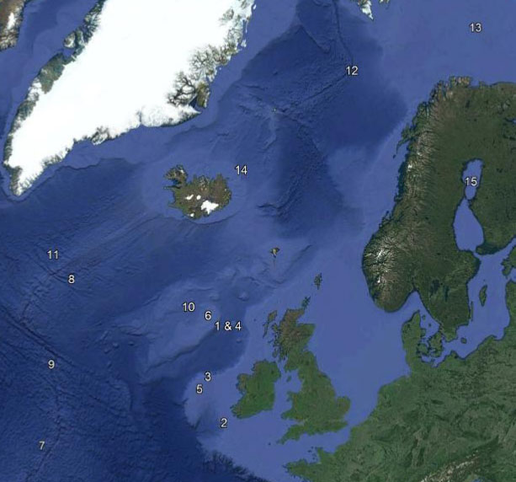
Weather Radio Sea WFS
WFS 2 29.09.40 U-103*
WFS 33 07.01.42 U-156
WFS 22 08.01.42 U-156
WFS B 28.04.42 U-159
WFS A 29.04.42 U-159
WFS 24.08.42 U-516
WFS 30.08.42 U-516
WFS 31.10.42 U-519
WFS 104 08.11.42 U-519
WFS 112 29.04.43 U-531
WFS 26.06.43 U-194**
WFS 106 23.07.43 U-703
WFS 107 27.07.43 U-703
WFS 133 10.09.44 U-703**
WFS 18.11.44 U-1165
* Operational testing
** U-boat lost before deployment
Buoys stored in over deck torpedo canisters – anchors in the over deck
Torpedo crane used to move heavy components – Limit: Wind 2, Swell 2, Sea State 2
Assembly and deployment took about 1.5 hours during which the boat could not dive

Slide 22
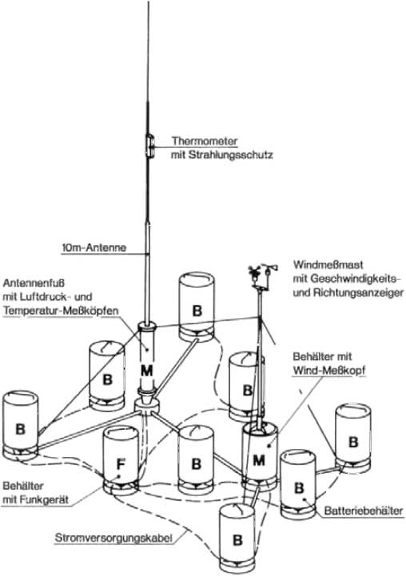
Weather Radio Land WFL
1 meter high steel pots 52 cm in diameter
Weighed no more than 100 kg each
Pot M – wind measurement sensors
Pot M – 10 meter antenna with temperature and air pressure sensors
Pot F – Lo150FK41a 150 Watt transmitter
Pot B – Sealed lead-acid batteries number depended on desired endurance
Air pressure, temperature, wind strength and direction were sampled 4 times/day
Encrypted in Morse code transmitted 10 times in up to 120 seconds
Designed for an endurance of 10-24 weeks
Notes:
Same components as WFS - 20 ordered in 1942

Slide 23
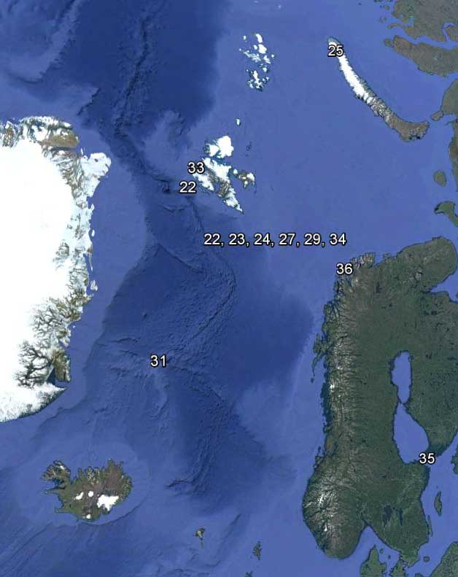
Weather Radio Land WFL
WFL Station Date Boat
21 “Gustav” Spitzbergen 29.09.42 U-377
22 “Edwin” Bäreninsel 01.12.42 U-657
23 “Edwin II” Bäreninsel 18.03.42 WBS 2
24 “Robert” Bäreninsel 09.07.43 U-629
25 “Gerhard” Nowaja Semlja 22.08.43 U-703
26 “Kurt” Labrador 23.10.43 U-537
27 “Dietrich” Bäreninsel 07.09.43 U-355
-- -- -- --
“Christian” Bäreninsel 06.12.43 U-713
“Herbert” Labrador -- .09.44 U-867*
“Walter” Jan Mayen 25.09.44 U-992
“Erich” Nowaja Semlja 15.10.44 U-387
“Edwin III” Spitzbergen 30.06.44 U-737
“Hermann” Bäreninsel 17.06.44 U-737
“Landjäger” Åland Insel 22.11.44 U-1165
“Wilhelm” Magerøya 11.11.44 U-1163
* Boat lost before deployment

Slide 24
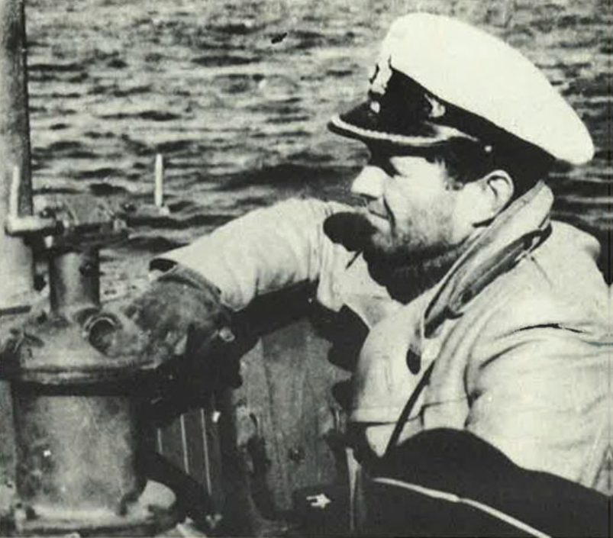
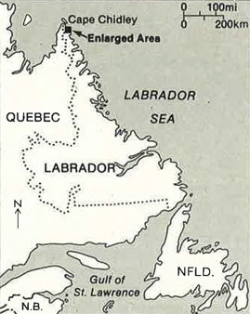
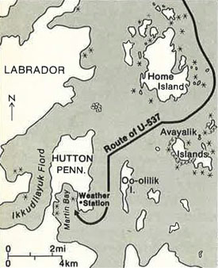
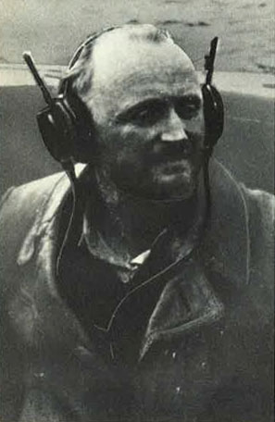
WFL 26 “Kurt”
U-537 Kptlt. Peter Schrewe was tasked to deploy Kurt
Departed Bergen on its first war patrol 30 Sep 1943
Meteorologists: Dr. Kurt Sommermeyer & Walter Hildebrant
Suffered damage from heavy seas during Atlantic crossing
Arrived at dawn 22 Oct off the Labrador coast
Notes:
Meteorologists: Dr. Kurt Sommermeyer & Walter Hildebrant

Slide 25
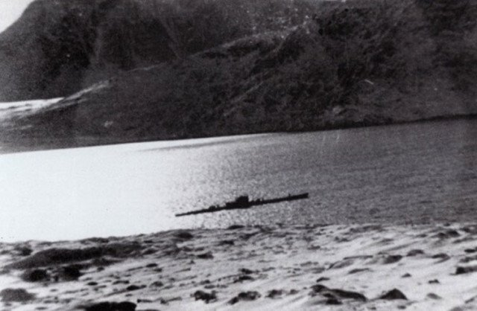
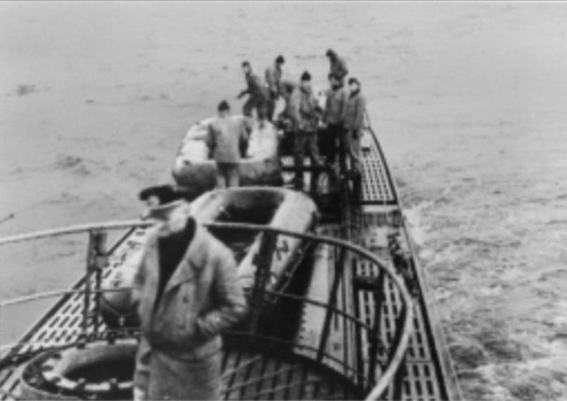
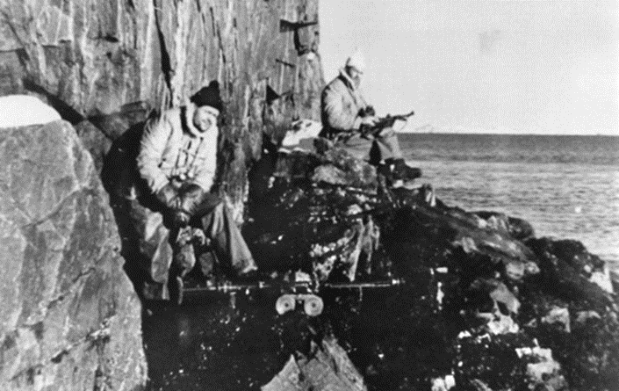
WFL 26 “Kurt”
U-537 anchored in Martin Bay at 12:00 local
Dr. Sommermeyer quickly identified the site
The meteorologists & ten sailors worked to put the station ashore by rubber boat over the beach 50 meters up a hill and 400 meters inland
Armed lookouts posted while other crew members repaired storm damage

Slide 26
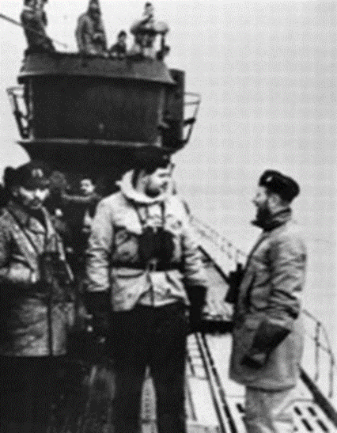
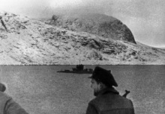
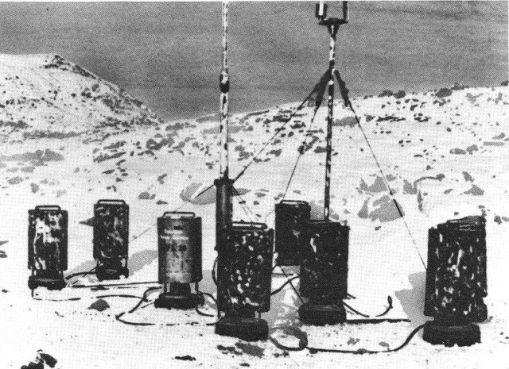
WFL 26 “Kurt”
Station was completed about 12:00 local the next day
Disguised by empty US cigarette packs strewn about and one canister marked “Canadian Metor. Service”
The boat waited until the first transmission was heard then put to sea
U-537 conducted an unsuccessful patrol off Newfoundland arrived in Lorient 8 Dec
Notes:
The boat’s next patrol took it to Batavia (Jakarta) where it was lost on 10 Nov 1944

Slide 27
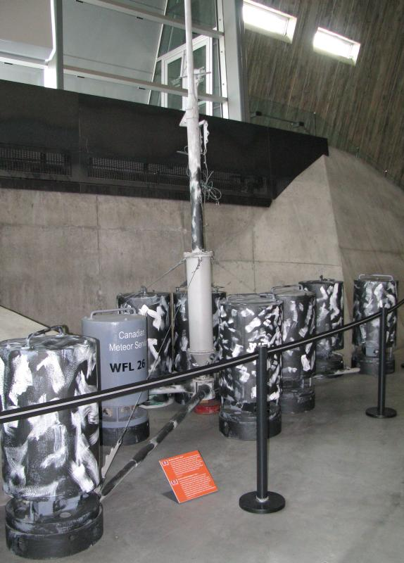
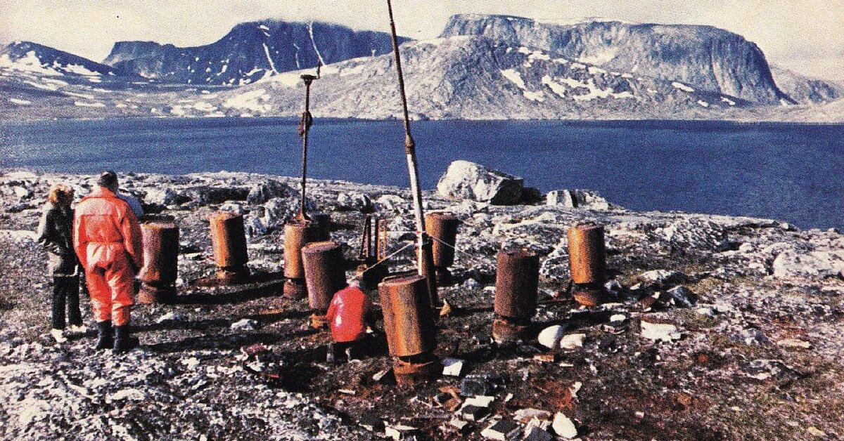
WFL 26 “Kurt”
Forgotten until 1977 Kurt was discovered by geomorphologist Peter Johnson
Retired Siemens engineer Franz Selinger contacted Canadian National Defense Historian W.A.B. Douglas
Douglas went to the site in 1981 and recovered the station
Kurt is now exhibited at the Canadian War Museum in Ottawa
Notes:
Peter Johnson named the station “Martin Bay”

Slide 28
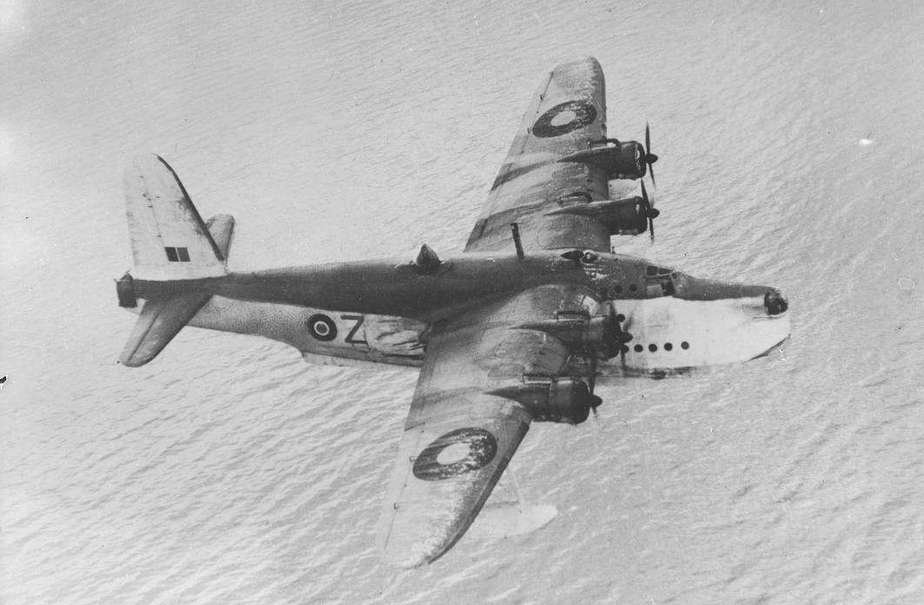

The End
Learn more about U-boats at:
http://uboatarchive.net
Download the presentation at:
http://uboatarchive.net/Presentations/Presentations.htm
See War Diaries (Kriegstagebuch - KTB) for boats that operated in Canadian waters: http://uboatarchive.net/CanadianWatersKTBs.htm
Contact me at s3bpilot@telus.net

